Slide 1

Assessment 2 Hobby Project QA Academy
M Chocianowski

Slide 2

Assessment Objective
This is my second assessment with the academy, this project is known as the hobby project and will and is intended to prove my knowledge and understanding of providing a Crud functional application with a back-end and front-end.

Slide 3



Planning
Jira
Risk Assessment
Risk Assessment Matrix

Slide 4
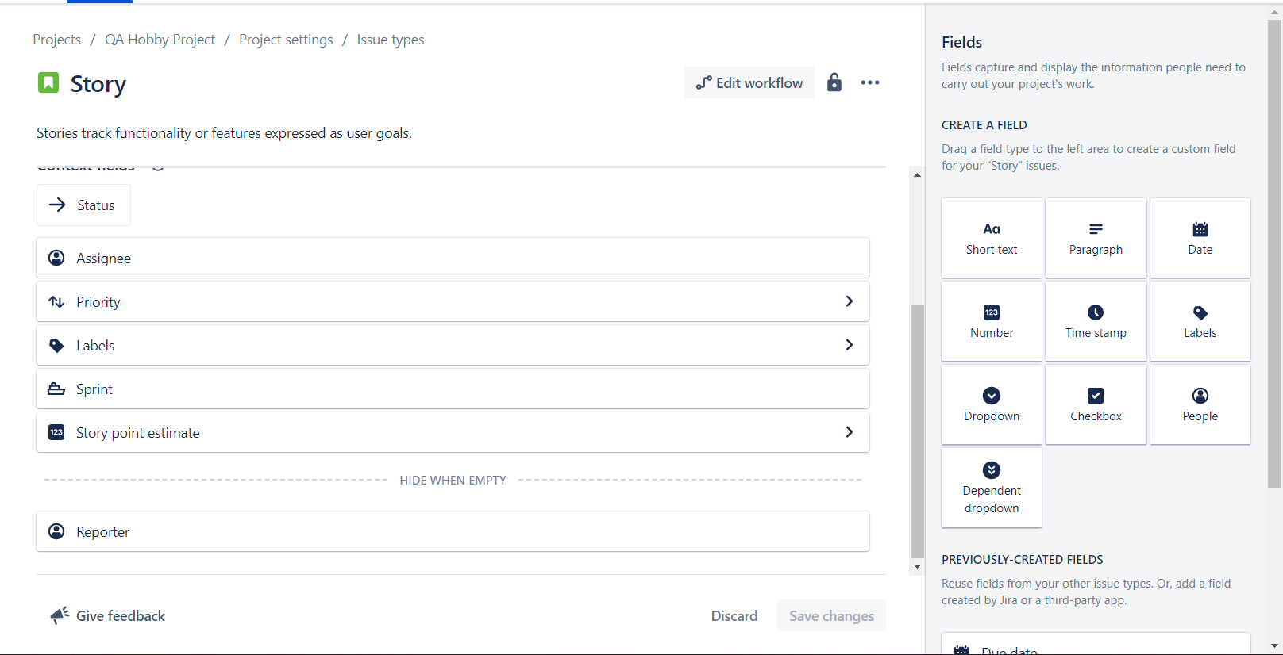
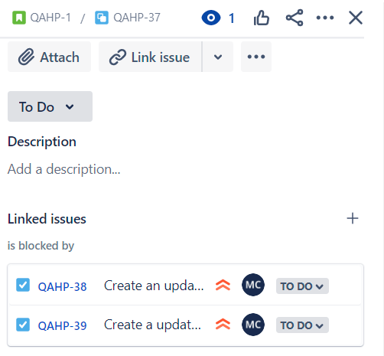
Jira
Adding fields to issues in settings
Adding child issues and linked issues to user stories

Slide 5
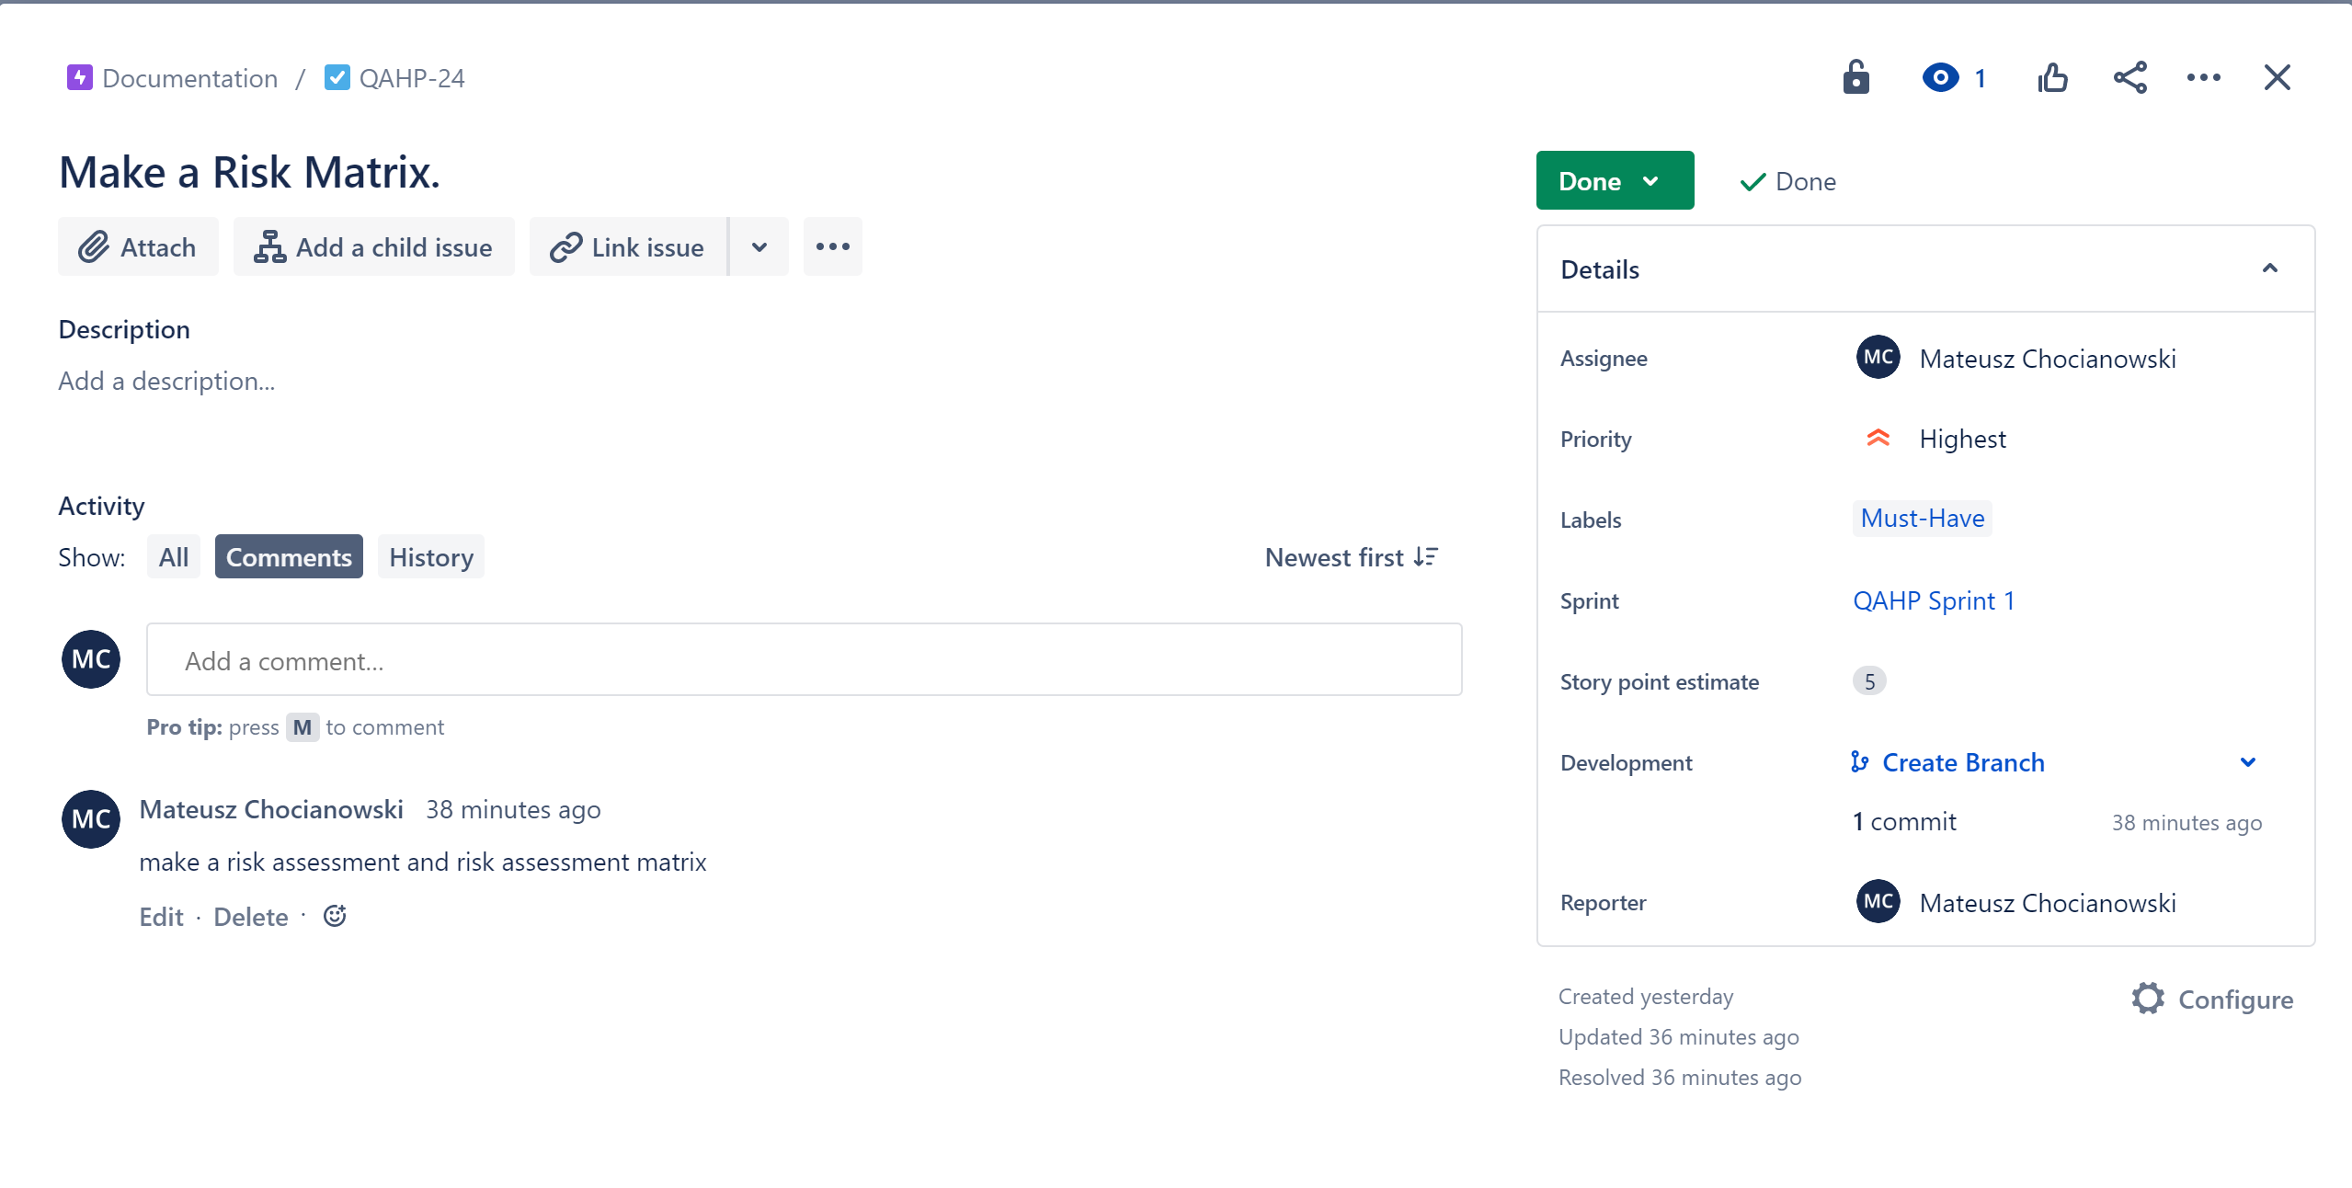
Jira Continued.
Linking GitHub and Jira to implement commit messages

Slide 6
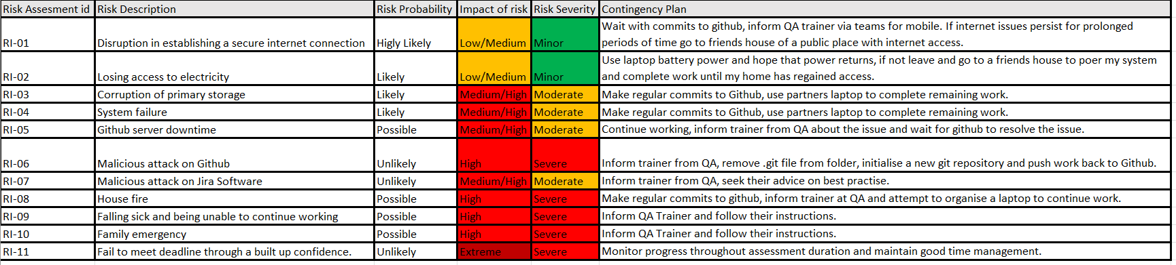
Risk assessment.

Slide 7
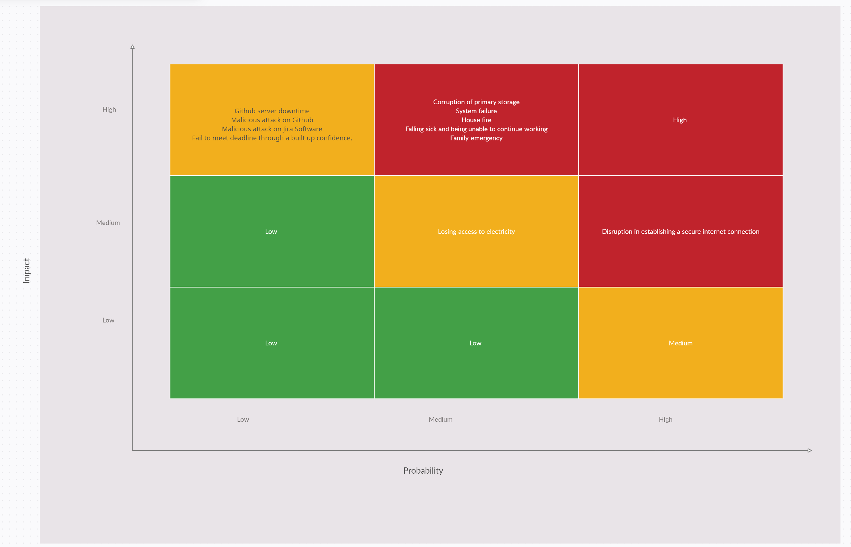
Risk Assessment Matrix.

Slide 8



Market summary
Remote work is more popular than ever, and companies are thinking about tools that create effective communication across teams.
Market trends will continue rising based on projections, which provides an opportunity for greater business reach in the region.
Our product cost is low, which gives us a market advantage.

Slide 9
Opportunities
Market gap
Costs
Few, if any, products on the market help customers like we do
Loss of productivity costing consumers thousands of dollars
Customers
Usability
66% of US consumers spend money on multiple products that only partially resolves their issue
Customers want something that is easy to use
Financials
Millennials account for about a quarter of the $48 billion spent on other products in 2018

Slide 10


Business overview

Slide 11

Business concept
Using our next-generation data architecture, we help organizations virtually manage agile workflows. We thrive because of our market knowledge and the great team behind our product.

Slide 12
Goals and objectives
Draft blueprints
Run focus groups
Gather feedback
Feb 20XX
May 20XX
Oct 20XX
20XX
JAN
FEB
MAR
APR
MAY
JUN
JUL
AUG
SEP
OCT
NOV
DEC
20XX
JAN
FEB
MAR
APR
MAY
JUN
JUL
AUG
SEP
OCT
NOV
DEC
Test design
Launch design
Deliver to client
Feb 20XX
July 20XX
Dec 20XX

Slide 13
Financials
Key metrics
Revenue by year
 | Clients | Orders | Gross revenue | Net revenue
20XX | 10 | 1100 | $10,000 | $7,000
20XX | 20 | 200 | $20,000 | $16,000
20XX | 30 | 300 | $30,000 | $25,000
20XX | 40 | 400 | $40,000 | $30,000

Slide 14
Financials table
 | YEAR 1 | YEAR 2 | YEAR 3 | DELTA
Income
Users | 50,000 | 400,000 | 1,600,000
Sales | 500,000 | 4,000,000 | 16,000,000
Average price per sale | 75 | 80 | 90
Revenue @ 15% | 5,625,000 | 48,000,000 | 216,000,000
Gross profit | 5,625,000 | 48,000,000 | 216,000,000
Expenses
Sales & marketing | 5,062,500 | 38,400,000 | 151,200,000 | 70%
Customer service | 1,687,500 | 9,600,000 | 21,600,000 | 10%
Product development | 562,500 | 2,400,000 | 10,800,000 | 5%
Research | 281,250 | 2,400,000 | 4,320,000 | 2%
Total expenses | 7,593,750 | 52,800,000 | 187,920,000

Slide 15

Risks and rewards
Risks
Rewards
New feature updates may not be popular with customers
Lack of staffing in key roles could delay product launch
Product will have more features which may require additional learning for customers
First on the market
Good publicity for the product so far, and we can build momentum from that scenario
Product testing with high-value clients have shown no issues

Slide 16

Key issues
Near term
Long term
Need funding in key roles
Lack of staffing will cause product delay
Need larger office space
Additional employees will require on-site office workspace

Slide 17
Thank you
Mirjam Nilsson​
206-555-0146
mirjam@contoso.com
www.contoso.com

